Slide 1
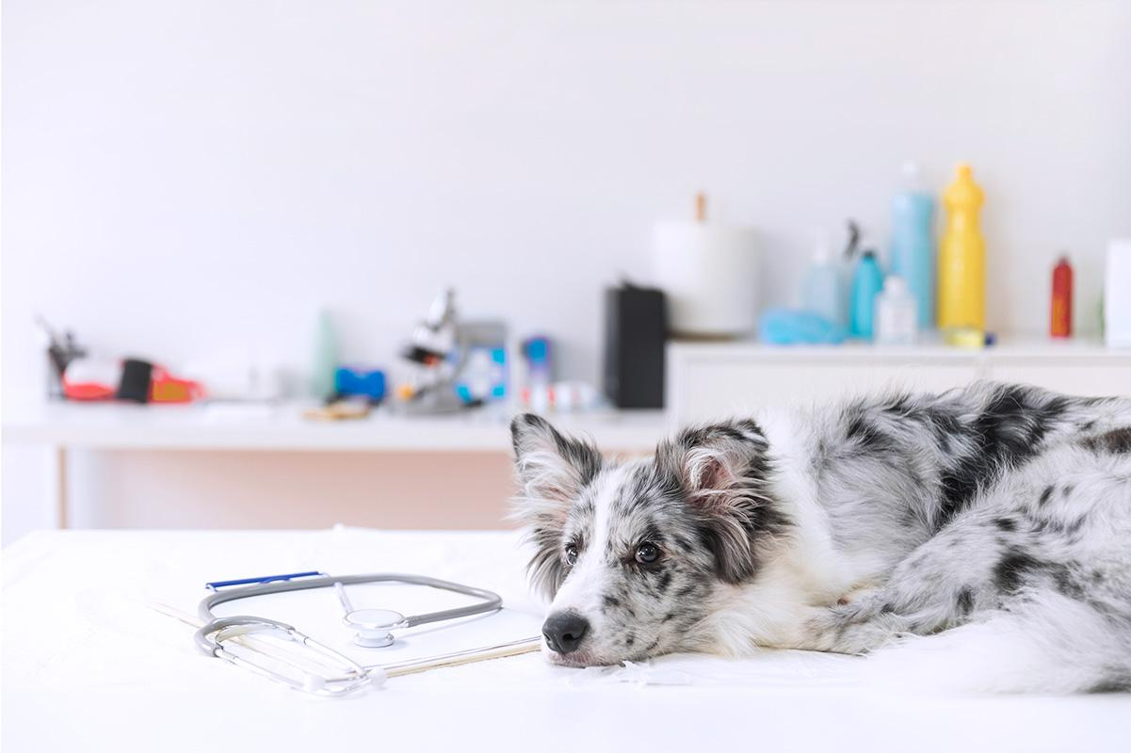
Power Puff Pet’s
Mobile Grooming Services, & Boutique

Slide 2
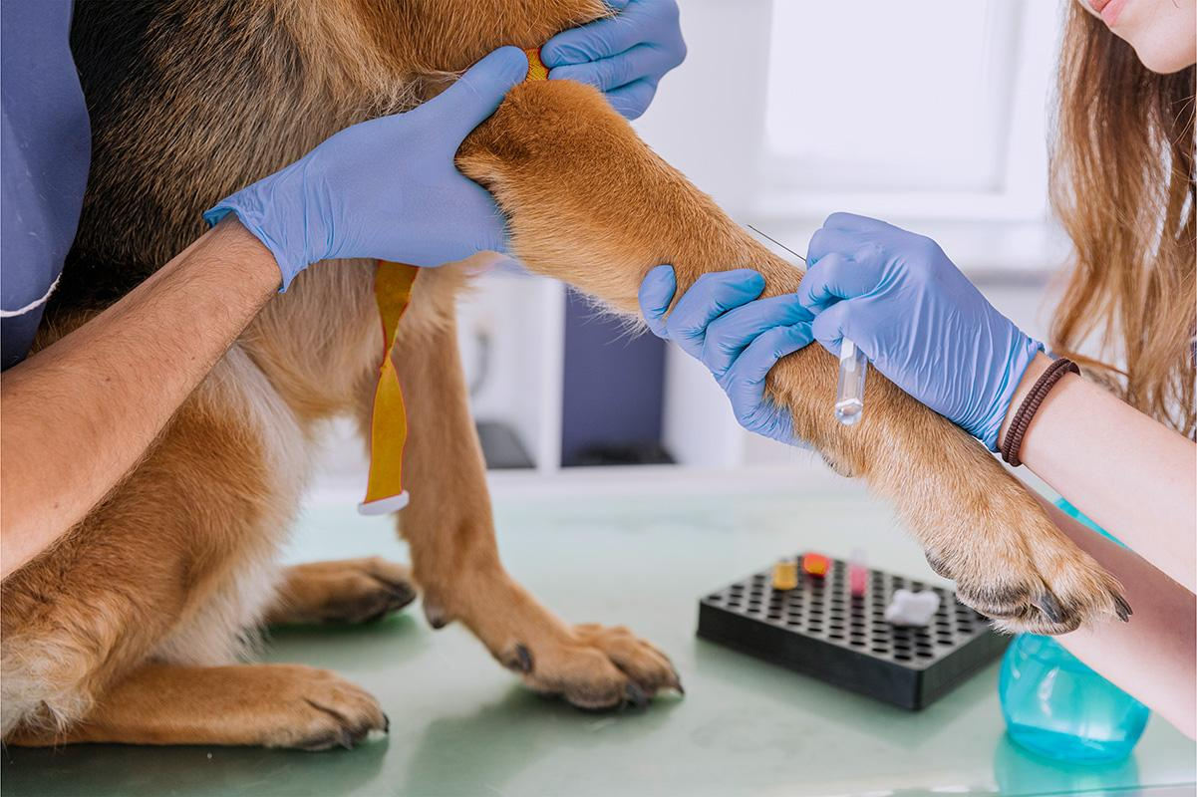
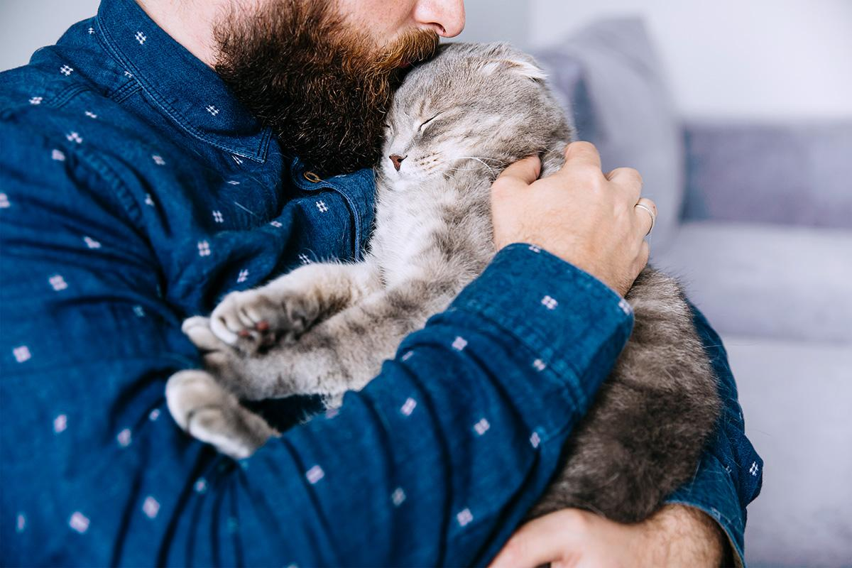
MISSION
VISION
To raise awareness about how much pets’ lives matter by providing consultants to pets owners, and to provide an excellent high-quality services and pet care products.
To be the number one choice for pet owners, to make a world where every pet is happy, healthy, and safe, and to provide the best quality services and products in our country.

Slide 3
TABLE OF CONTENTS
01
02
03
04
OUR SERVICES & PRODUCTS
OUR NUMBERS
Reason for Raising Additional Funds
OUR PLANS
Current and future
3 Statements
Financial Models
Why?
How much?
For payment
For investment
For investors

Slide 4
SERVICES & PRODUCTS
Products
Food: Wet food, dry food, seeds, organic options, treats (cookies, biscuits)
Supplements
Grooming products: Shampoos, nail clippers, brushes
Toys
Cages
Beds
Transportations (carriers)
Accessories: Collars, tags

Slide 5
SERVICES & PRODUCTS
Service
NOW
Grooming services
Consulting services
Engraving
Product Subscription: monthly, annual
Membership; a loyalty services program that includes discounts, priority, new products samples, and early access

Slide 6
SERVICES & PRODUCTS
Service
FUTURE
Hotel
Daycare
Vet. (check-ups, vaccines, etc.)
Training

Slide 7
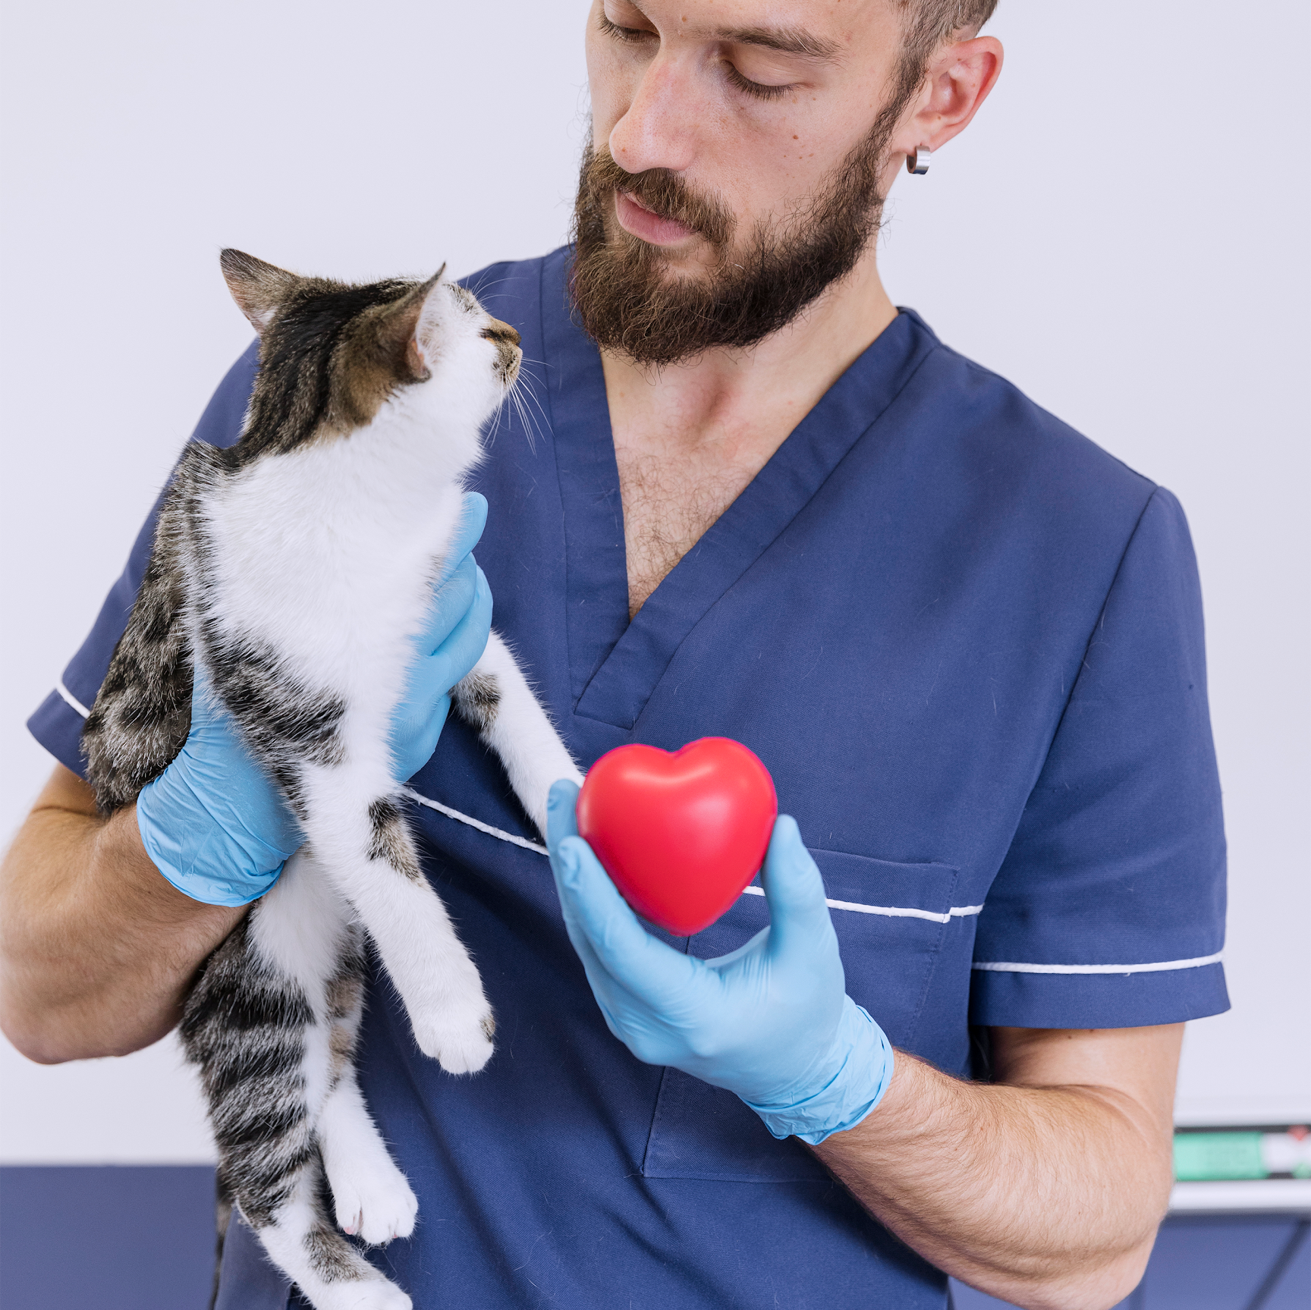
1
Year of operation

Slide 8
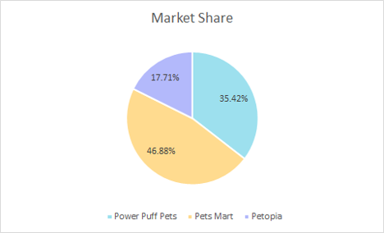
Market share and list of competition

Slide 9
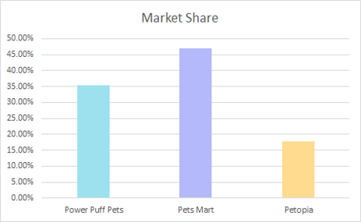
Increase/ Decrease in market share

Slide 10
How Much?
$287k

Slide 11
Reasons for Raising Additional Funds
To expand and own our first store
To Dominate the Market
To provide more services
01
02
03

Slide 12
PLANS
Vet Services
Hotel
01
02
Day Care
Training
03
04
Include a variety of specialists
You won't ever have to worry about your pet when you are away
Because everyone needs a friend
Essential for a healthy relationship

Slide 13
NUMBERS
 | Year 0 | Year 1
Grooming | $80 | $170
Vet | - | $345
Hotel/Day Care | - | $430
Training | - | $265

Slide 14
OUR TEAM
Wejdan Al-Ahmadi
Norah Alharthi
Fadak Aldar
Sara Aldubaie
Nouf Alrehaili

Slide 15
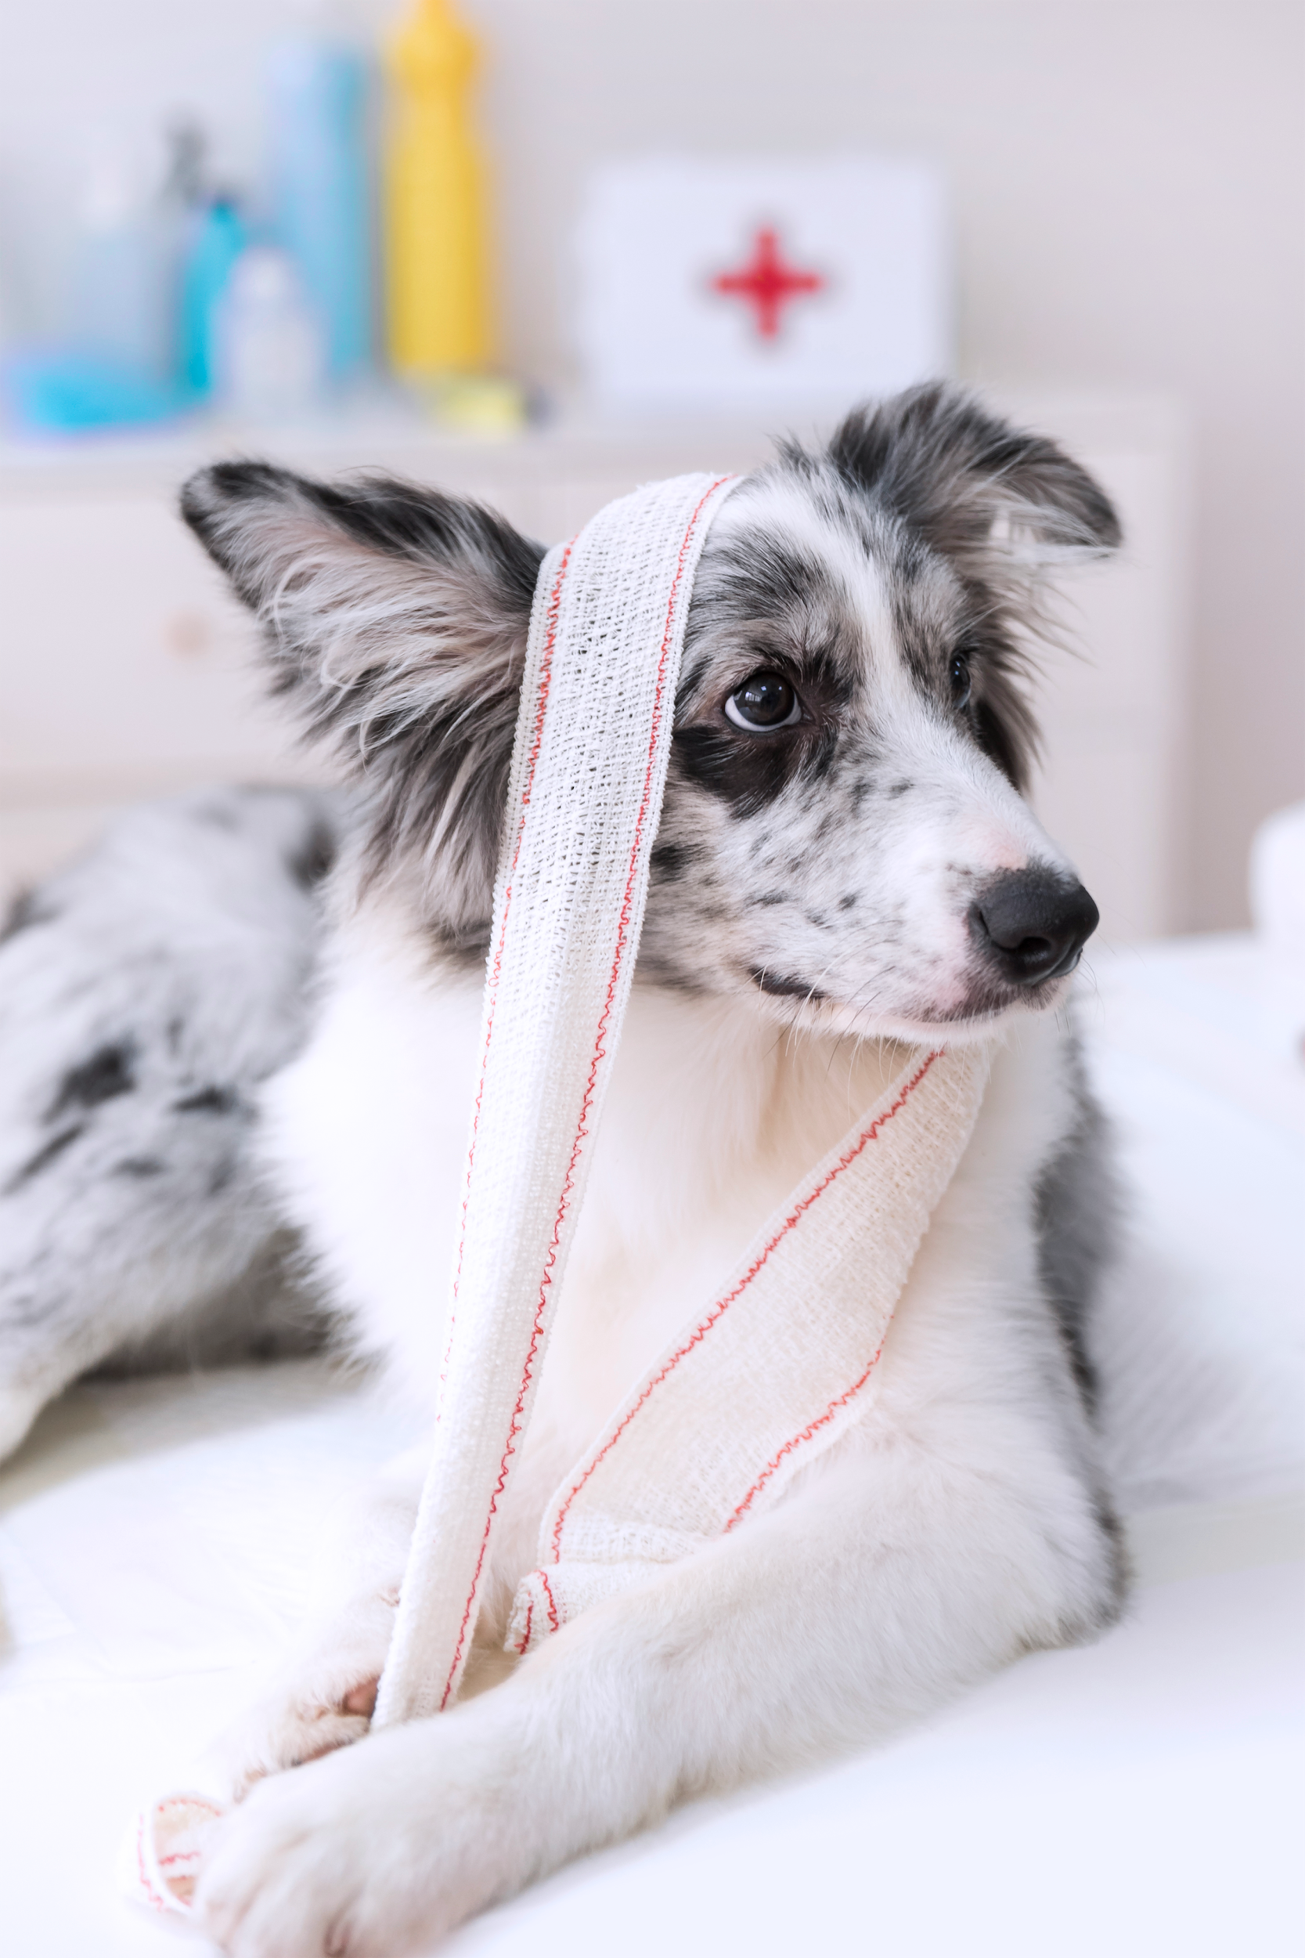
THANKS
Do you have any questions?

